Slide 1

MECH 430 Instrumentation and Measurements Lab Smart Home Project
Karim AbouCham
Jad Yahya
Karim Abdo

Slide 2
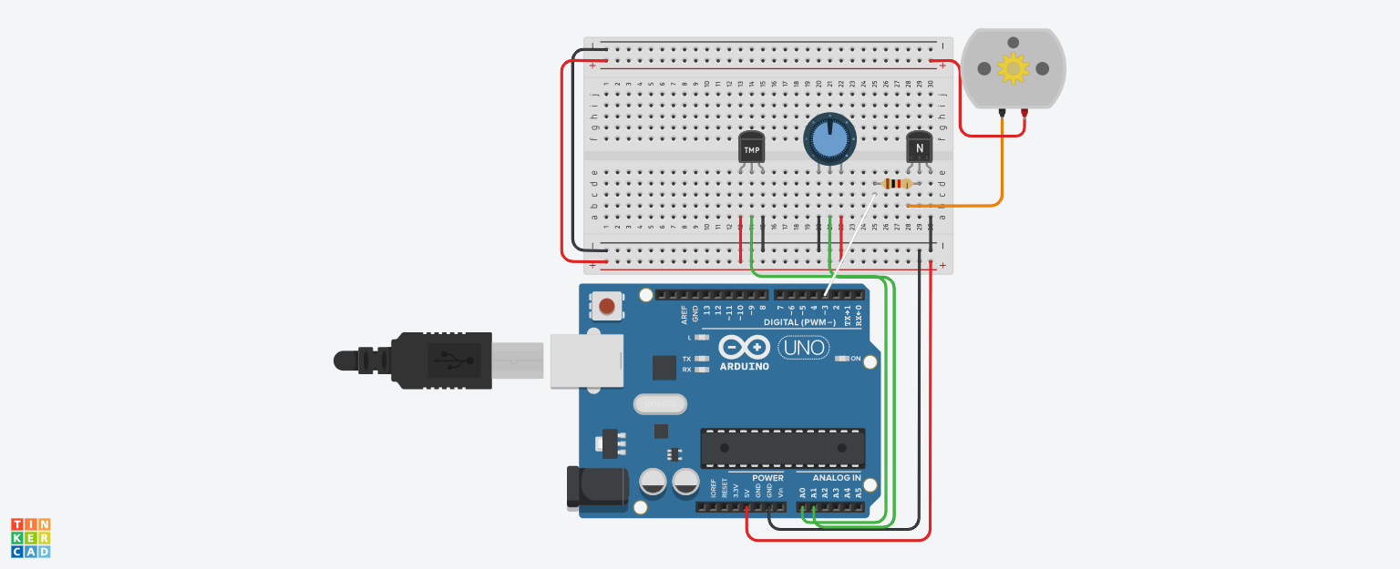
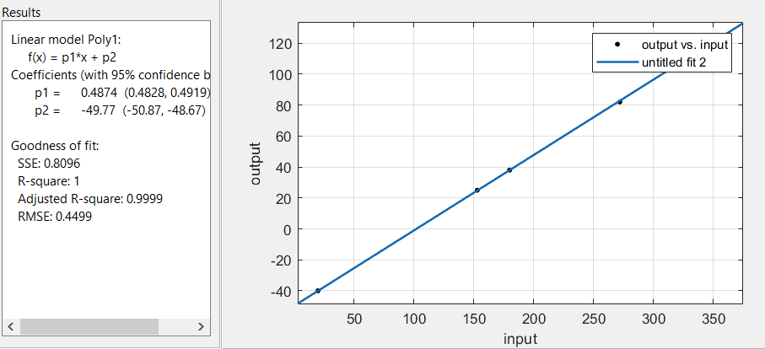

A-B- Temp + Fan Control: Circuit and Calibration

Slide 3
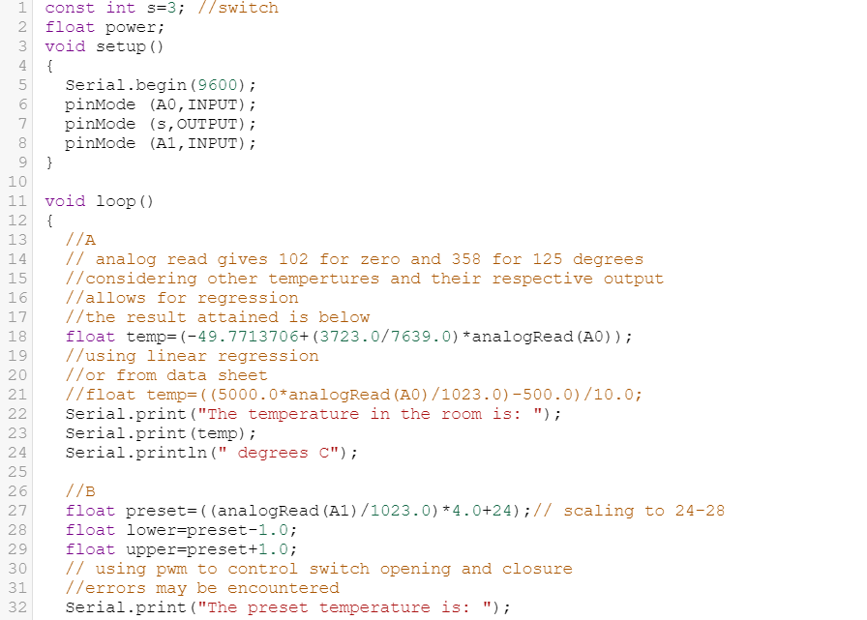
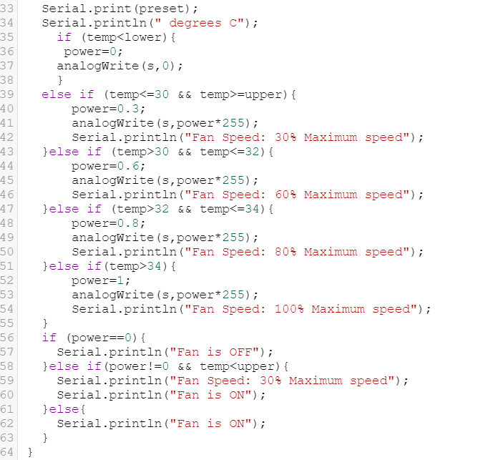
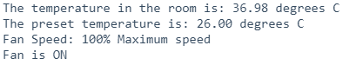
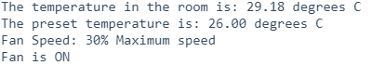
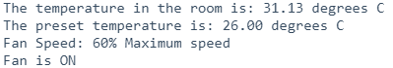
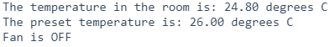
A-B- Temp + Fan Control: Code
Code:
Sample Outputs:

Slide 4
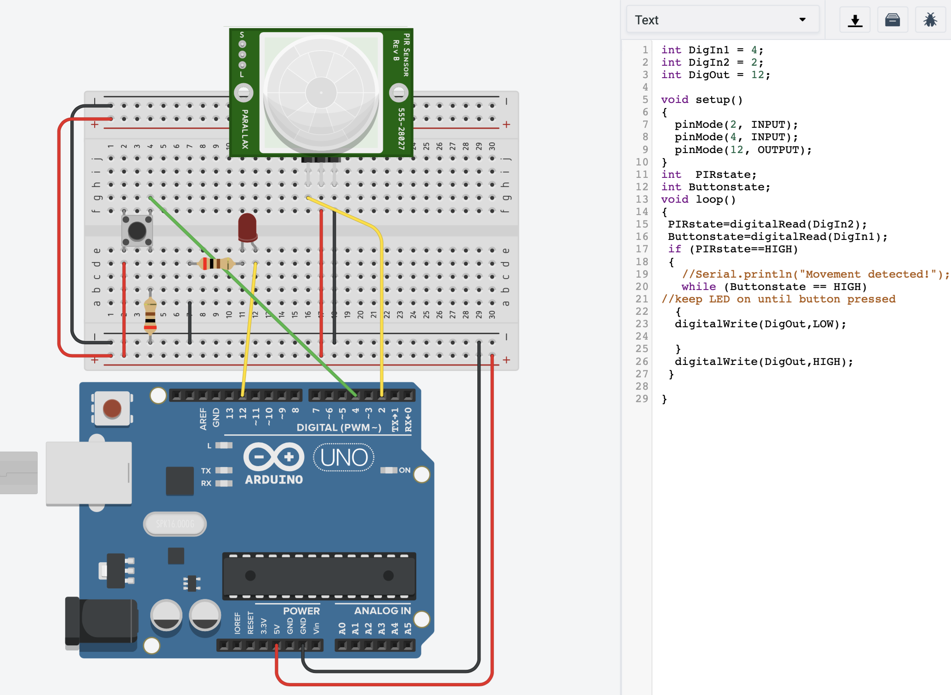

C- PIR Sensor Reading: Circuit and Code

Slide 5
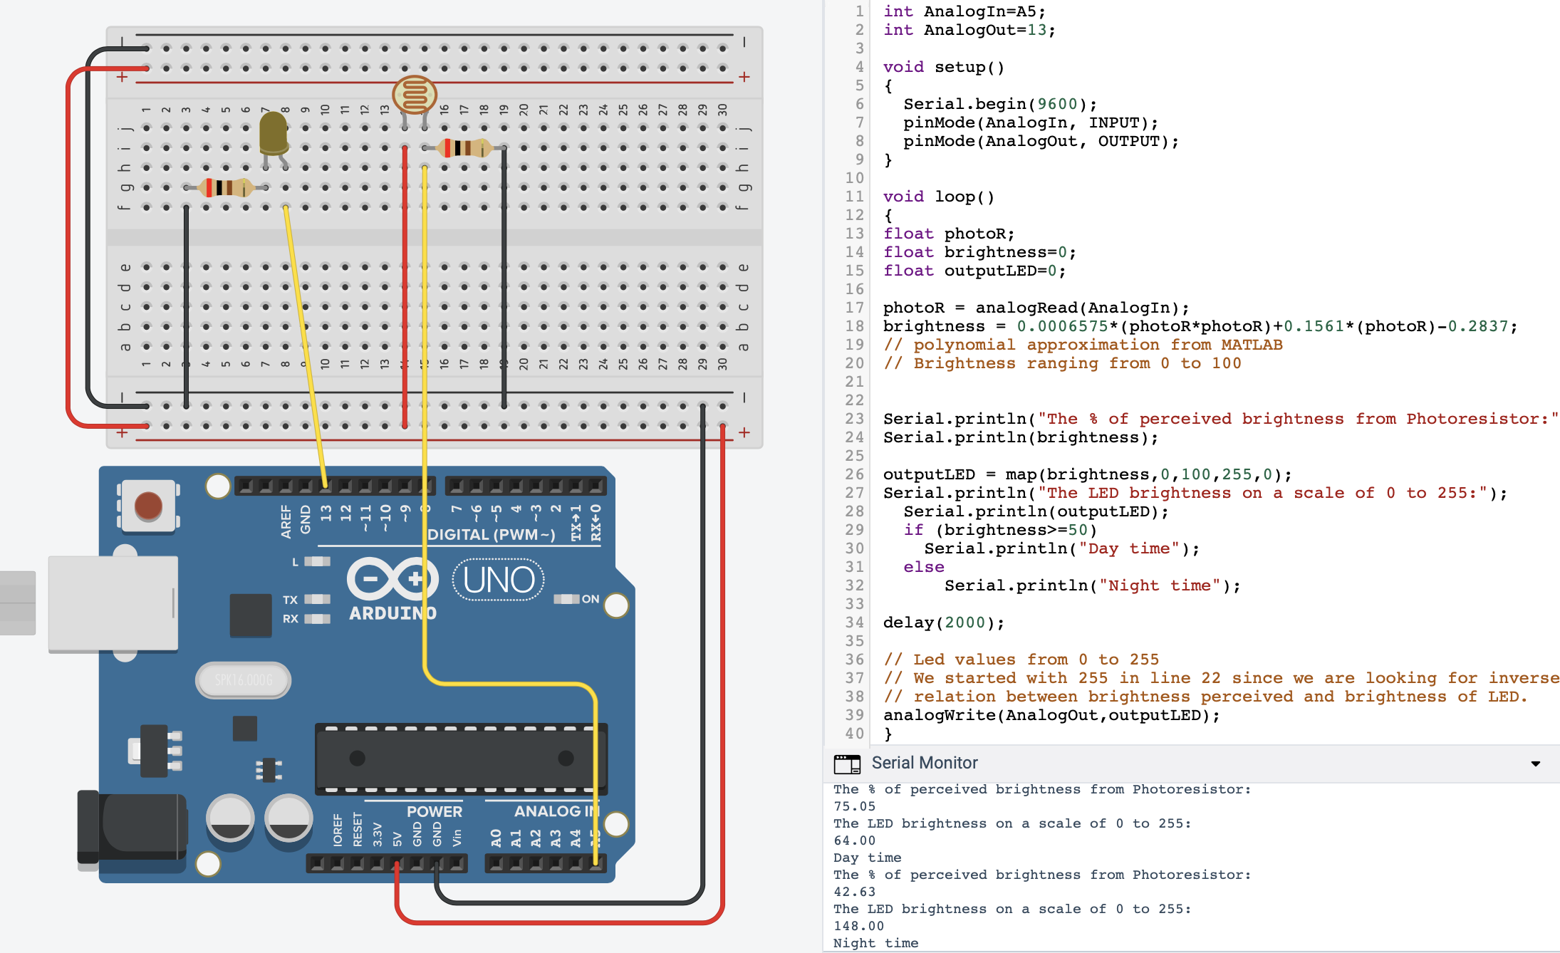
D-Time and Light Detection: Circuit and Code

Slide 6
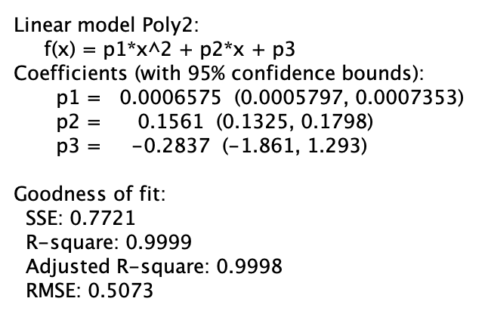
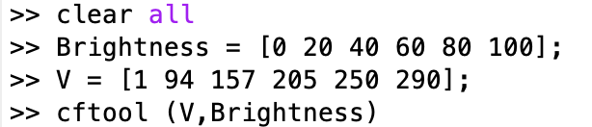
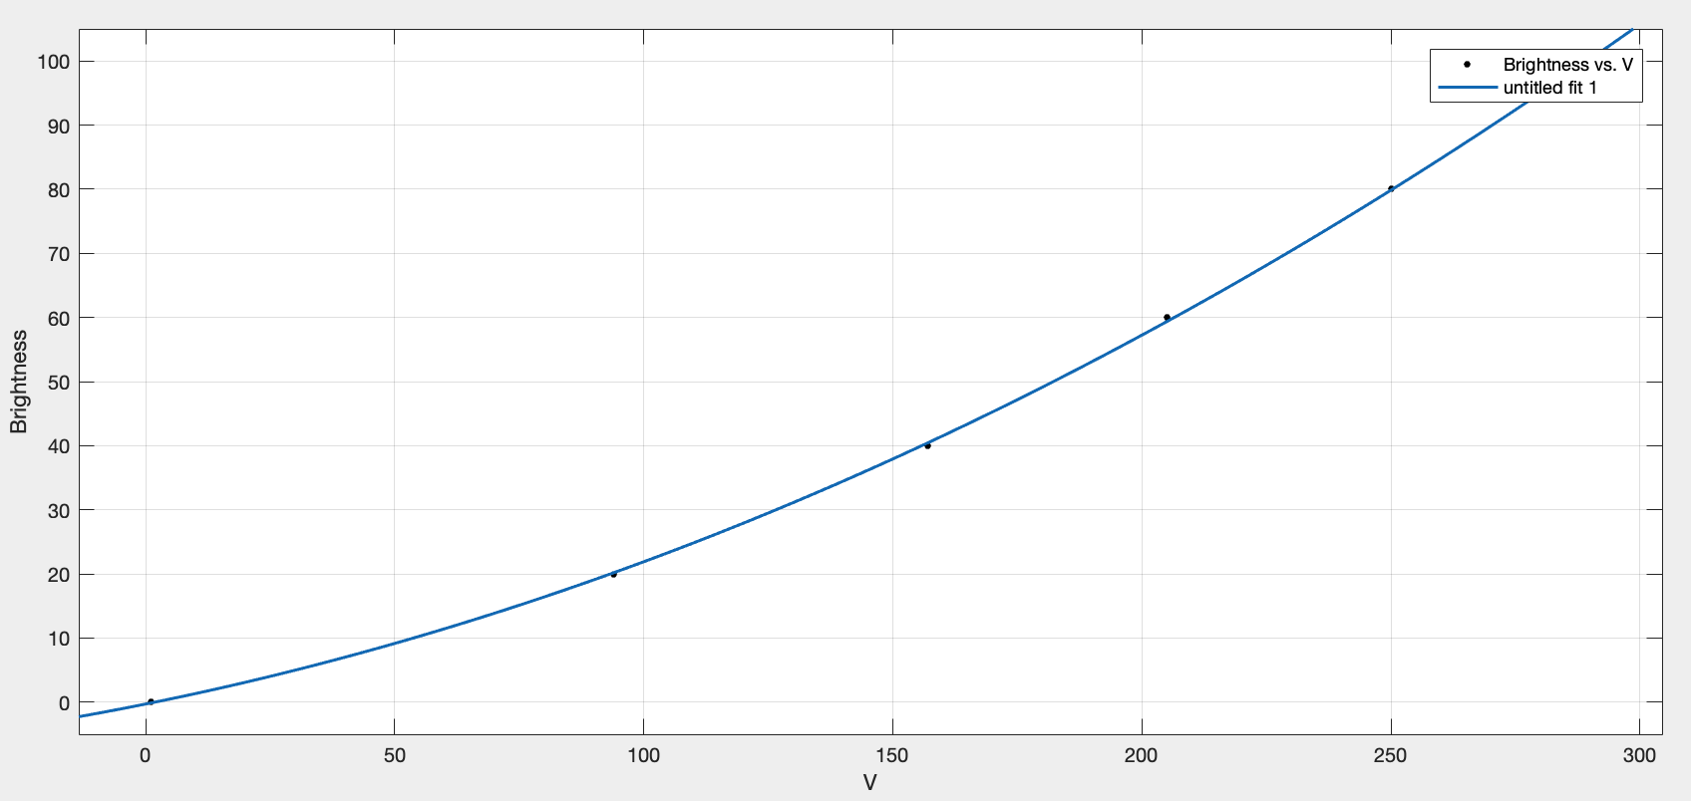
D-Time and Light Detection: Calibration

Slide 7
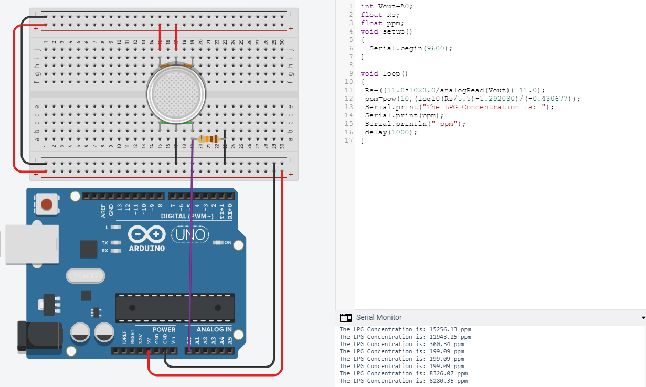
E- Gas Leakage Detection: Circuit and Code

Slide 8
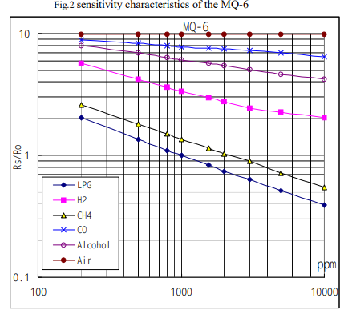
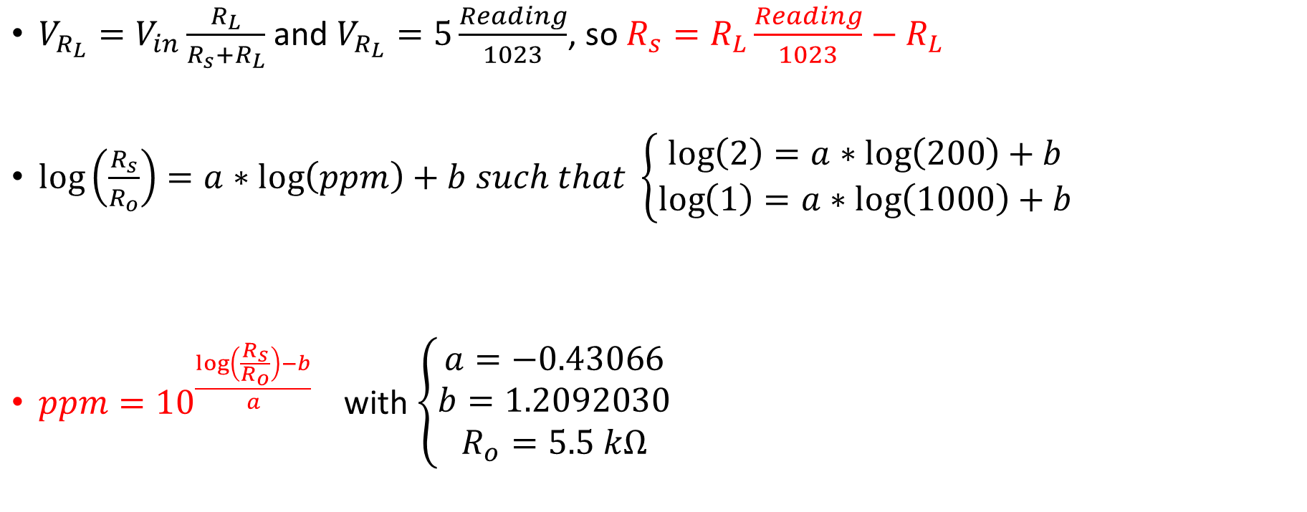
E- Gas Leakage Detection: Calibration
$V_{R_{L}}=V_{in}\frac{R_{L}}{R_{s}+R_{L}}$ and $V_{R_{L}}=5\frac{Reading}{1023}$, so $R_{s}=R_{L}\frac{Reading}{1023}−R_{L}$
$\log\left(\frac{R_{s}}{R_{o}}\right)=a∗\log\left(ppm\right)+b such that \left\{\begin{aligned}\log\left(2\right)=a∗\log\left(200\right)+b \\ \log\left(1\right)=a∗\log\left(1000\right)+b\end{aligned}\right.$
$ppm={10}^{\frac{\log\left(\frac{R_{s}}{R_{o}}\right)−b}{a}}$ with $\left\{\begin{aligned}a=−0.43066 \\ b=1.2092030 \\ R_{o}=5.5 kΩ\end{aligned}\right.$

Slide 9
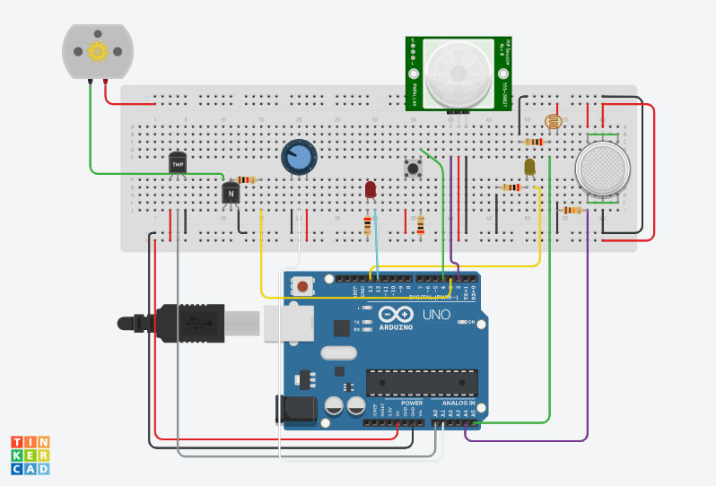
Smart Home Project Circuit

